Slide 1
Parent & Family Session
Notes:
Template Page – Duplicate and use as needed.

Slide 2
Parent & Family Services
Defining New Roles
See Parent & Family Weekend Dates!
Parent & Family Involvement
Visit Campus – but not too often
Campus Events – Family Weekends, Athletic Events, Guest Speakers, Concerts, Theatre Productions, Musicals, and Orientation.
Siblings have feelings too!
Share stories
Picture books and memories
Make them part of the process
Parent & Family Session
parents@vinu.edu
888-852-3940
812-888-5004
Notes:
Template Page – Duplicate and use as needed.

Slide 3
Parent & Family Services
Big Differences
Not high school
Grades are NOT released/mailed home
TAPS
Adjusting to academics
What’s an academic advisor?
Clarify beliefs & values
The
College
Journey
Notes:
Template Page – Duplicate and use as needed.

Slide 4
Parent & Family Services
Roadmap to Success
Getting Information
Family Education Rights and Privacy Act (FERPA)
Generally, written consent from your student is necessary before information can be released
Talk to your student TODAY about the Information Release Form. The form is available at the Records Office.
Students Need to Be Prepared
Students need books the first
week of classes
Books are considered an
out-of-pocket expense – Save Now!
Talk to your student about the Release of Information Form
Notes:
Template Page – Duplicate and use as needed.

Slide 5
Parent & Family Services
Planning Ahead for College Expenses
Out-of-pocket expenses
Books are an out of pocket expense
$300 to $500 average per semester
Try to purchase used books when possible
Textbook Rental Program
Parking Permits $30
Tools $$$
Art Supplies $$$
Check out the VU Bookstore!
Notes:
Template Page – Duplicate and use as needed.

Slide 6
Parent & Family Services
Planning Ahead for College Expenses
What does Financial Aid cover?
In this order:
Tuition and Academic fees
Student Activity fee
Housing and Meal Plan
Books
IMPORTANT: Books can only be charged to the student account IF there is enough accepted financial aid!
Notes:
Template Page – Duplicate and use as needed.

Slide 7
Parent & Family Services
GET
INVOLVED!
Living On Campus
Benefits
Halls Staffed 24/7
Furnished Rooms
Each student has a desk, dresser, closet, and bed (extra long twin)
Meal Plan
Walking Distance to Class
Resources Close
Challenges
Homesickness
Roommates
Time Management
Getting to class
Doing homework
Laundry
Making new friends
Making Good Decisions
Time Management
Notes:
Template Page – Duplicate and use as needed.

Slide 8
Parent & Family Services
GET
INVOLVED!
Commuting From Home
Or
Living Off Campus
Benefits
Closer to Family
Bring Friends Home
Know Community
Less Likely to Become Homesick
Easier to Keep Track of Study Habits
Challenges
Finding ‘Their Place’
Family Dynamic
Study Time
Time Management
Transportation
Participating in Events
Notes:
Template Page – Duplicate and use as needed.

Slide 9
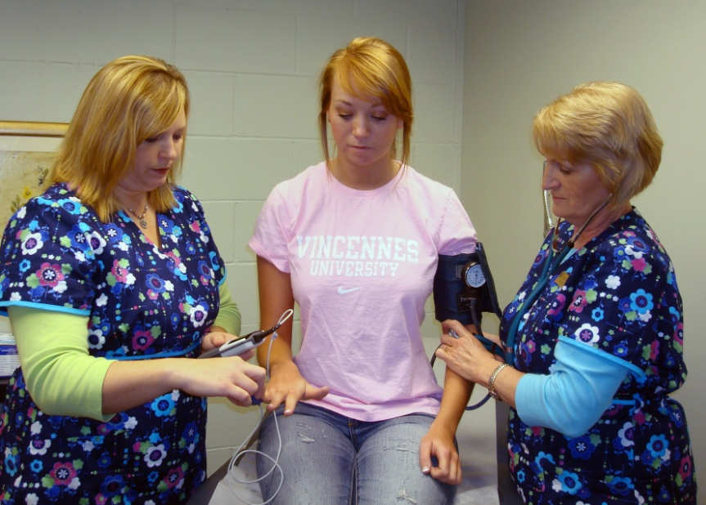
Parent & Family Services
VU Health Services
UPCC: University Primary Care Center
Located in the Young Building
Nurse Practitioner and Nursing Staff
Resident Hall students cannot opt out of UPCC Services.
Off campus students and commuter
students can opt out of
UPCC Services.
Notes:
Template Page – Duplicate and use as needed.

Slide 10
Parent & Family Services
Immunization Laws and Records
Immunization Laws
2- Measles vaccines
1- MMR
1- Tetanus/Diphtheria
Meningitis shot or waiver
Health Occupations
Child Care Majors
EMS
Fire Science
Physical including TB test
Recommended
Hepatitis B series
Chickenpox vaccine
If your student does NOT submit the appropriate immunizations to the Financial Services Office, a HOLD will be placed on their account!
Notes:
Template Page – Duplicate and use as needed.

Slide 11
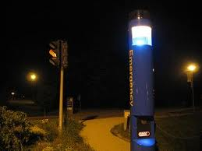
Parent & Family Services
VUPD & Campus Safety
Fully Empowered Police Department
Provide help
Enforce the law
Provide student escorts
Facilitate crime prevention seminars
Safety is everyone’s responsibility
Record valuables
Keep doors locked
Keep medicine out of sight
See parking permit instructions
Students should Sign Up for Emergency Notifications
(E-text) at MyVU
Notes:
Template Page – Duplicate and use as needed.

Slide 12
Parent & Family Services
Looking for Resources?
Look to the VU Web Pages for Information
Upcoming Events & Campus Announcements
Lodging & Hotel Information
Sandy’s Food Pantry
VU Mini-Triathlon
Join the E-newsletter
Know what’s going on each month!
Join the PFS Facebook Group
Facebook.com/groups/vuparents
Call and Email the Parent Services Office
vinu.edu/parents
parents@vinu.edu
888-852-3940
812-888-5004
Notes:
Template Page – Duplicate and use as needed.

Slide 13
Thank you for attending!
Don’t forget to stop by the Information Tent outside Jefferson Union for a bottle of water!
Notes:
Opening Graphic

